Slide 1


Java ee
(ADVANCE JAVA)
Lecture-39

Slide 2
Today’s Agenda
Introduction To JSP Directives
The @page Directive
Attributes of @page Directive
The @include Directive

Slide 3
DIRECTIVES IN JSP
Directives are instructions given by programmer to the jsp container and based on them the container takes different actions while translating the page from jsp to java .
A JSP directive affects the overall structure of the servlet class and usually has the following form:
<%@ directive attribute="value" %>

Slide 4
DIRECTIVES IN JSP
Overall we have three directives called:
The “page” Directive .
The “include” Directive.
The “taglib” Directive.

Slide 5
THE “page” DIRECTIVE
As the name indicates page directive is used to specify the properties or attributes of jsp page as a whole.
The container uses these attributes while translating the jsp page to a servlet.
It’s general syntax is:
<%@page attribute=“value” %>

Slide 6
ATTRIBUTES OF page DIRECTIVE
Following are important attributes of @page directive:
language
import
extends
session
buffer
autoFlush
contentType
errorPage
isErrorPage
isThreadSafe

Slide 7
THE language ATTRIBUTE
<%@page language=“java”%>
This attribute tells the container what language the programmer wants to use for scriplets , declrative tag and expression tags .
It’s default value is java but can be changed to any other language provided the container supports the language

Slide 8
THE import ATTRIBUTE
<%@ page import=“java.util.*,java.sql.*”%>
This attribute is used to describe what packages or classes we want to use in our jsp page .
By default container always include 4 packages and they are:
java.lang
javax.servlet
javax.servlet.http
javax.servlet.jsp

Slide 9
THE extends ATTRIBUTE
Normally the jsp container supplies the parent class for the servlet it generates from a jsp page .
But if we want then we can supply our own class which the jsp generated servlet should extend .
However in practical sense it is not recommended to do this as it means that we are trying to interfere with internal working of the container .

Slide 10
THE extends ATTRIBUTE
Still if we want to use this feature then we must follow two rules :
Our class should inherit HttpJspBase.
It must provide 3 methods :
jspInit()
jspDestroy()
_jspService()

Slide 11
THE session ATTRIBUTE
<%@ page session = “false”%>
This attribute is a boolean attribute whose default value is true but if we are not performing session tracking then we must set it to false.

Slide 12
THE buffer ATTRIBUTE
<%@ page buffer=“16kb”%>
This attribute is use to specify buffer size for our page
Buffers are areas in servers memory where the response generated by a jsp is copied.
And whenever the buffer is full then container translates or sends the buffer data to the browser.
The default size of buffer is 8kb but can be increased to any multiple of 8 as per our requirement .

Slide 13
THE autoFlush ATTRIBUTE
<%@ page autoFlush=“true”%>
This attribute specifies what the container should do if the buffer is full.
If it is set to true which is it’s default value then as soon as the buffer gets full the container sends the response to the client .
But if it is sets to false then programmer has to take care of flushing the buffer otherwise as the buffer becomes full an exception occurs.

Slide 14
THE contentType ATTRIBUTE
<%@ page contentType=“text/html”%>
This attribute is nothing but the format of data being sent by Web server to client as response. It is received by the browser on the client system and displayed to the user.
It’s default value is text/html, that is, either simple text or text with HTML but can be changed to any valid MIME format as per the requirements like “image/jpeg” , “text/plain” , “application/msword” etc

Slide 15
THE errorPage AND isErrorPage ATTRIBUTES
<%@ page isErrorPage=“true”%>
<%@ page errorPage=“ep.jsp”%>
If we haven’t used try catch in our JSP page and suppose an exception occurs then the application displays HTTP-500 error code to the user which is not a professional practice .
JSP has provided mechanism to generate simple error messages without using try catch .

Slide 16
THE errorPage AND isErrorPage ATTRIBUTES
To do this we take two steps:
Create a jsp page with isErrorPage=“true” .
By doing this we designate the jsp page as an error page so that whenever an exception occurs in other jsp pages the container called this page.

Slide 17
THE errorPage AND isErrorPage ATTRIBUTES
In other jsp pages we set the attribute errorPage assigning it the name of the jsp page for handling errors.
Now whenever the exception occurs container will
automatically call jsp page set as error page .
Also we get a special object called exception which
provides details of the exception .

Slide 18
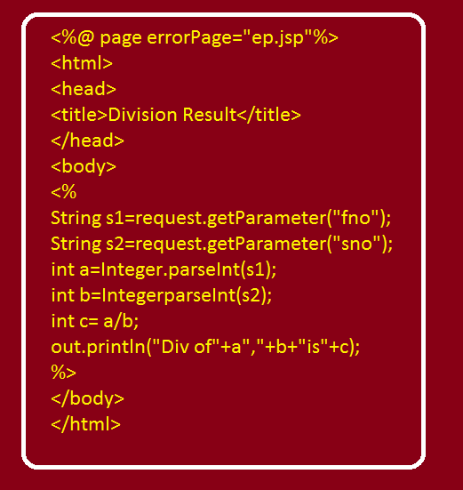
EXAMPLE

Slide 19
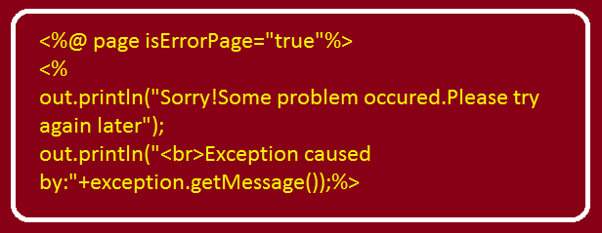
EXAMPLE

Slide 20
THE isThreadSafe ATTRIBUTE
<%@ page isThreadSafe=“true” %>
This attribute specifies how a web server will dispatch the multiple client request. It has either the true or false value.
By default value of this attribute is set to true. The true value specifies that the web container can dispatch the multiple client request to the JSP page and the false value specifies that the web container can dispatch a single request at a time in the specified order.

Slide 21
THE include DIRECTIVE
Whenever a web application is developed there might be a situation when we would like to have some common output to be displayed in every jsp page .
For ex: we might want to display current date in every jsp page .
For this we have two solutions:
To write the code to generate the date in every page separatlely ,but it will have code duplicacy.
Much better solution is to use include directive.

Slide 22
THE include DIRECTIVE
In this approach , we can design a jsp page which can generate current date and in other jsp pages we can attach this jsp page by using the include directive.
Moreover ,we can also attach html pages in our jsp page using this directive.
It’s general syntax is :
<%@include file =“resource_name"%>
The “resource_name” here indicates the name of the jsp
or html page which we want to include in the current page

Slide 23
EXAMPLE (The HTML Page)
<html>
<head>
<title>Include Directive Demo</title>
</head>
<body><center>
<form action="welcome.jsp">
<b>Enter your name:</b><input type="text" name="username"><br>
<input type="submit" value="submit">
</form>
</center>
</body>
</html>

Slide 24
EXAMPLE (The welcome.jsp Page)
<html>
<head>
<title>Welcome Page</title>
</head>
<body><center>
<%
String user=request.getParameter("username");
%>
<h3>Welcome To Home Page Dear <%= user %></h3> <br>
<%@ include file="showdate.jsp" %>
</center>
</body>
</html>

Slide 25
EXAMPLE (The showdate.jsp Page)
<%@page import="java.util.*,java.text.*" %>
<%
Date today=new Date();
SimpleDateFormat sdf=new SimpleDateFormat("dd-MMM-yyyy");
String str=sdf.format(today);
%>
Current System Date is :<%= str %>

Slide 26

End Of Lecture
For any queries mail us @: scalive4u@gmail.com
Call us @ : 0755-4271659, 7879165533
Agenda for Next Lecture:
Introduction To Session Tracking
Session Tracking Mechanisms
Using Hidden Fields For Session Tracking

